Slide 1


Deny Rahmalianto
September 4, 2022

Slide 2

Outline
Executive Summary
Introduction
Methodology
Results
Conclusion
Appendix

Slide 3
Executive Summary
The methodologies that are used in the presentation:
Data collection using API and Webscrapping
Preprocessing
Exploratory data analysis through data visualization
Machine learning prediction
Summary of all results
Taking time to preprocess and learn about the data is extremely crucial in order to make a good model.

Slide 4
Introduction
The project is a part of coursera course for Applied Data Science Capstone. In this project we learn the end to end of data scientist steps, from collecting data, preprocessing the data, exploring the data, creating models, as well as making final presentation.
This project would like to answers what are the steps that are needed in making data science analysis.

Slide 5

Section 1

Slide 6
Methodology
Executive Summary
Data collection methodology:
Data is collected from Space X using API as well as web scrapping
Perform data wrangling
Convert categorical data into numeric
Replacing null data with the mean
Perform exploratory data analysis (EDA) using visualization and SQL
Perform interactive visual analytics using Folium and Plotly Dash
Perform predictive analysis using classification models
Data were split into train and test to avoid bias
Several machine learning method were compared in order to find the best model
Several parameters were compared at hyperparameter tuning in order to find the best parameter

Slide 7
Data Collection
Data were collected using 2 ways:
API from: https://api.spacexdata.com/v4/payloads/
Web Scrapping from: https://en.wikipedia.org/wiki/List_of_Falcon\_9\_and_Falcon_Heavy_launches

Slide 8
Data Collection – SpaceX API
Request API
Normalize and convert the response into Dataframe
Filter data only using Falcon 9
Replace missing value with the mean
Source code: https://github.com/rahmalianto/Coursera-Applied-Data-Science-Capstone/blob/master/Data%20Collection%20API.ipynb

Slide 9
Data Collection - Scraping
Create soup object
Create object using beautifulsoup
Request data from URL
Insert url that is about to be scrapped
Extract information
Get key element in the HTML
Turn data into table
Normalize data using dataframe
Github Link: https://github.com/rahmalianto/Coursera-Applied-Data-Science-Capstone/blob/master/Data%20Collection%20with%20Web%20Scraping.ipynb

Slide 10
Data Wrangling
First, check null values in every columns
Second check whether data types is already as expected
Third learn the data distribution
Convert data categorical into numeric
Export the data
Check null values
Check data types
Explore data distribution
Convert categorical data into numeric
Export data into CSV
Source code: https://github.com/rahmalianto/Coursera-Applied-Data-Science-Capstone/blob/master/Data%20Wrangling.ipynb

Slide 11
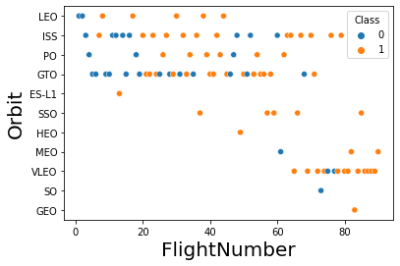
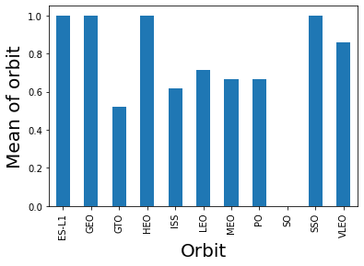
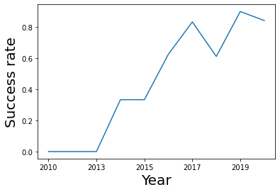
EDA with Data Visualization
Visualize the relationship between variables using scatter plot
Check the success rate of each orbit type
Check the success rate trend annually
Source code: https://github.com/rahmalianto/Coursera-Applied-Data-Science-Capstone/blob/master/EDA%20with%20Visualization.ipynb

Slide 12
EDA with SQL
Here are the list of tasks perform during the course:
Display the names of the unique launch sites in the space mission
Display 5 records where launch sites begin with the string 'CCA’
Display the total payload mass carried by boosters launched by NASA (CRS)
Display average payload mass carried by booster version F9 v1.1
List the date when the first successful landing outcome in ground pad was acheived.
List the names of the boosters which have success in drone ship and have payload mass greater than 4000 but less than 6000
List the total number of successful and failure mission outcomes
List the names of the booster_versions which have carried the maximum payload mass. Use a subquery
List the failed landing_outcomes in drone ship, their booster versions, and launch site names for in year 2015
Rank the count of landing outcomes (such as Failure (drone ship) or Success (ground pad)) between the date 2010-06-04 and 2017-03-20, in descending order
Source code: https://github.com/rahmalianto/Coursera-Applied-Data-Science-Capstone/blob/master/EDA%20with%20SQL%20Lab.ipynb

Slide 13
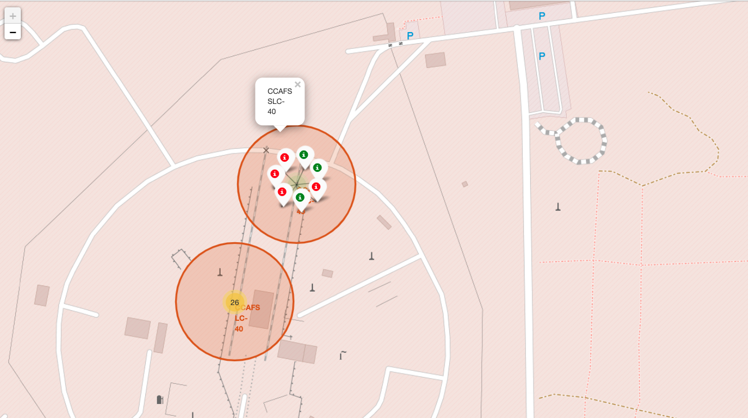
Build an Interactive Map with Folium
• Markers are used to mark launch sites
• Circles are used to highlight areas;
• Marker clusters are used to groups several markers
• Lines are used to annotate distances between two points.
Source code: https://github.com/rahmalianto/Coursera-Applied-Data-Science-Capstone/blob/master/Interactive%20Visual%20Analytics%20with%20Folium.ipynb

Slide 14
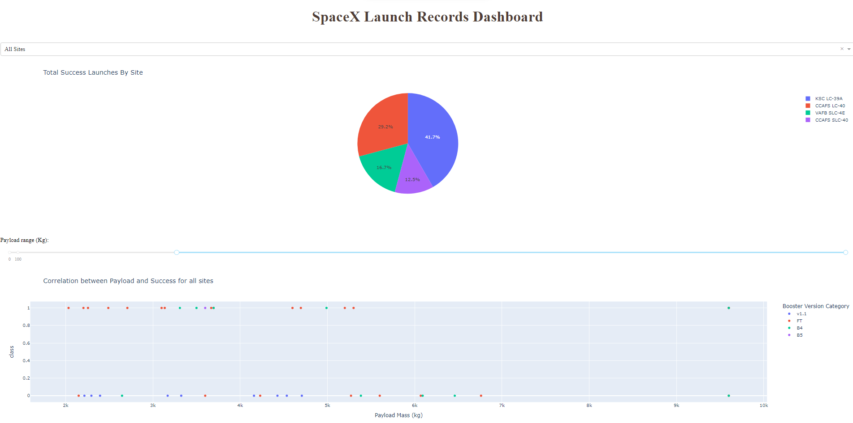
Build a Dashboard with Plotly Dash
Pie chart is used to show proportion
Scatter plot is used to show the relationship between variables
Source code: https://github.com/rahmalianto/Coursera-Applied-Data-Science-Capstone/blob/master/spacex_dash_app.py

Slide 15
Predictive Analysis (Classification)
First we split dataset into train and test
Define parameters for hyperparameter tuning
Apply to several algorithms
Compare which algorithms and parameters perform best
Split data into test and train
Define parameter for tuning
Compare algorithms
Implement several algorithms
Source code: https://github.com/rahmalianto/Coursera-Applied-Data-Science-Capstone/blob/master/Predictive%20Analysis.ipynb

Slide 16
Results
Payload mass affects the probability of launch success
Certain orbit type has a better success rate
Decision tree perform better in predicting success/failure of a rocket launch

Slide 17

Section 2

Slide 18
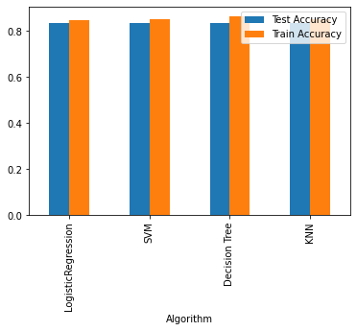
Classification Accuracy
For test accuracy, almost all model perform the same, however for train accuracy, decision tree perform way better than the other.

Slide 19
Conclusions
As the flight number increases, the first stage is more likely to land successfully
LEO orbit the Success appears related to the number of flights; on the other hand, there seems to be no relationship between flight number when in GTO orbit
Certain orbit type has a better success rate
Decision tree perform better in predicting success/failure of a rocket launch

Slide 20
Appendix
Github repository: https://github.com/rahmalianto/Coursera-Applied-Data-Science-Capstone/tree/master

Slide 21


